Slide 1


Slide 2

NAME :- Manasi Narendra Pawar
Batch :- ML9 FST 2.0

Slide 3


Project Name
Gender
Prediction

Slide 4
Content
Introduction
About the dataset
Real Life Example
Libraries
Algorithm
Data Visualization
Application
References Link
Conclusion

Slide 5

INTRODUCTION
Gender refers to the characteristics of women, men, girls and boys that are socially constructed. This includes norms, behaviours and roles associated with being a woman, man, girl or boy, as well as relationships with each other. As a social construct, gender varies from society to society and can change over time.

Slide 6
ABOUT THE DATASET
1.Exploratory Data Analysis
2. Data Visualisation
3.Splitting the data into test and train
4.Classification Models
5. Final Result
6.Deployment phase

Slide 7
REAL LIFE EXAMPLE
Gender roles in society means how we’re expected to act, speak, dress, groom, and conduct ourselves based upon our assigned sex. For example, girls and women are generally expected to dress in typically feminine ways and be polite, accommodating, and nurturing. Men are generally expected to be strong, aggressive, and bold.

Slide 8




LIBRARIES
 | NumPy is a Python package. It stands for 'Numerical Python'. It is a library consisting of multidimensional array objects and a collection of routines for processing of array.
 | Pandas is a Python library used for working with data sets. It has functions for analyzing, cleaning, exploring, and manipulating data.
 | Seaborn is a Python data visualization library based on matplotlib. It provides a high-level interface for drawing attractive and informative statistical graphics. Seaborn is a library that uses Matplotlib underneath to plot graphs. It will be used to visualize random distributions.
 | Scikit-learn (Sklearn) is the most useful and robust library for machine learning in Python. It provides a selection of efficient tools for machine learning and statistical modeling including classification, regression, clustering and dimensionality reduction via a consistence interface in Python.

Slide 9
ALGORITHM
Logistic Regression
Logistic regression is one of the most popular Machine Learning algorithms, which comes under the Supervised Learning technique. It is used for predicting the categorical dependent variable using a given set of independent variables.
Logistic regression predicts the output of a categorical dependent variable. Therefore the outcome must be a categorical or discrete value. It can be either Yes or No, 0 or 1, true or False, etc. but instead of giving the exact value as 0 and 1, it gives the probabilistic values which lie between 0 and 1. whereas Logistic regression is used for solving the classification problems.

Slide 10
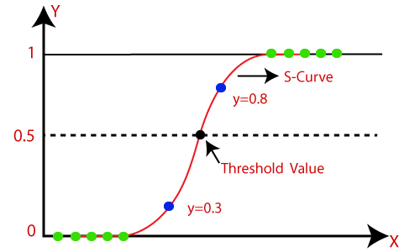
Logistic Function (Sigmoid Function):
The sigmoid function is a mathematical function used to map the predicted values to probabilities.
It maps any real value into another value within a range of 0 and 1.
The value of the logistic regression must be between 0 and 1, which cannot go beyond this limit, so it forms a curve like the "S" form. The S-form curve is called the Sigmoid function or the logistic function.
In logistic regression, we use the concept of the threshold value, which defines the probability of either 0 or 1. Such as values above the threshold value tends to 1, and a value below the threshold values tends to 0.

Slide 11
Confusion Matrix in Machine Learning
A confusion matrix is a matrix that summarizes the performance of a machine learning model on a set of test data.
It is often used to measure the performance of classification models, which aim to predict a categorical label
for each input instance.The matrix displays the number of true positives (TP), true negatives (TN), false positives (FP),
and false negatives (FN) produced by the model on the test data.
Accuracy:
Accuracy is used to measure the performance of the model.
It is the ratio of Total correct instances to the total instances
Precision:
Precision is a measure of how accurate a
model’s positive predictions are.
Recall:
Recall measures the effectiveness of a classification model in
identifying all relevant instances from a dataset.
F1-Score:
F1-score is used to evaluate the overall performance of a
classification model. It is the harmonic mean of precision and recall

Slide 12
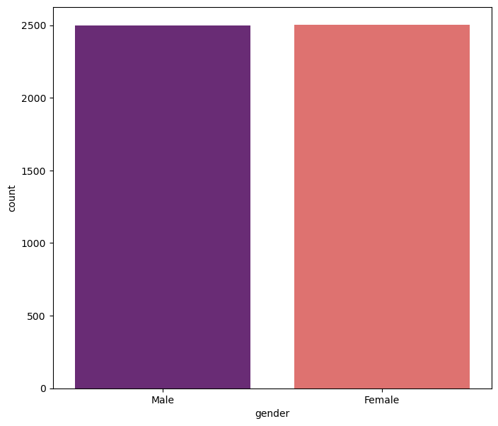
DATA VISUALIZATION
plt.figure(figsize=(8,7))
sns.countplot(x='gender',data=df, palette='magma')

Slide 13
APPLICATIONS
Workplace Diversity and Inclusion Initiatives
Education and Curriculum Development
Healthcare Services
Media Representation
Sports and Recreation

Slide 14
REFERENCES LINK
'/kaggle/input/gender-classification-dataset/gender_classification_v7.csv'

Slide 15
CONCLUSION
Gender is a social construct. The way males and females are treated differently since birth moulds their behaviour and personal preferences into what society expects for their gender.This small dataset is designed to provide an idea about whether a person's gender can be predicted with an accuracy significantly above 50% based on their personal preferences.

Slide 16


